Slide 1


Database Systems
BITS Pilani
Hyderabad Campus

Slide 2
ER to Relational Mapping (Ch. 8 of T1)
Content
Mapping Regular Entity types
Mapping Weak Entity types
Mapping 1:1 Relationships
Mapping 1:N Relationships
Mapping N:M Relationships
Mapping Multivalued and Complex attributes
Mapping class hierarchies

Slide 3
Mapping entity types
Mapping of Regular Entity Types.
For each regular (strong) entity type E in the ER schema, create a relation R that includes all the simple attributes of E.
Choose one of the key attributes of E as the primary key for R.
If the chosen key of E is composite, the set of simple attributes that form it will together form the primary key of R.

Slide 4
Mapping of Weak Entity Types
For each weak entity type W in the ER schema with owner entity type E, create a relation R & include all simple attributes (or simple components of composite attributes) of W as attributes of R.
Also, include as foreign key attributes of R the primary key attribute(s) of the relation(s) that correspond to the owner entity type(s).
The primary key of R is the combination of the primary key(s) of the owner(s) and the partial key of the weak entity type W, if any.

Slide 5
Mapping Relationship types
3. Mapping of Binary 1:1 Relation Types
For each binary 1:1 relationship type R in the ER schema, identify the relations S and T that correspond to the entity types participating in R.

Slide 6
There are three possible approaches:
Foreign Key approach: Choose one of the relations-say S- and include a foreign key in S that refers to the primary key of T. It is better to choose an entity type with total participation in R in the role of S.
Merged relation option: An alternate mapping of a 1:1 relationship type is possible by merging the two entity types and the relationship into a single relation. This may be appropriate when both participations are total.
Cross-reference or relationship relation option: The third alternative is to set up a third relation R for the purpose of cross-referencing the primary keys of the two relations S and T representing the entity types.

Slide 7
Mapping of Binary 1:N Relationship Types.
For each regular binary 1:N relationship type R, identify the relation S that represent the participating entity type at the N-side of the relationship type.
Include as foreign key in S the primary key of the relation T that represents the other entity type participating in R.
Include any simple attributes of the 1:N relation type as attributes of S.

Slide 8
Mapping of Binary M:N Relationship Types.
For each regular binary M:N relationship type R,
create a new relation S to represent R.
Include as foreign key attributes in S the primary keys of the relations that represent the participating entity types; their combination will form the primary key of S.
Also include any simple attributes of the M:N relationship type (or simple components of composite attributes) as attributes of S.

Slide 9
Mapping Multivalued attributes
Mapping of Multivalued attributes.
For each multivalued attribute A, create a new relation R.
This relation R will include an attribute corresponding to A, plus the primary key attribute K-as a foreign key in R-of the relation that represents the entity type of relationship type that has A as an attribute.
The primary key of R is the combination of A and K. If the multivalued attribute is composite, we include its simple components.

Slide 10
Mapping n-ary relationships
Mapping of N-ary Relationship Types.
For each n-ary relationship type R, where n>2, create a new relationship S to represent R.
Include as foreign key attributes in S the primary keys of the relations that represent the participating entity types.
Also include any simple attributes of the n-ary relationship type (or simple components of composite attributes) as attributes of S.

Slide 11
Mapping n-ary relationships
Example: The relationship type SUPPY in the ER on the next slide.
This can be mapped to the relation SUPPLY shown in the relational schema, whose primary key is the combination of the three foreign keys {SNAME, PARTNO, PROJNAME}

Slide 12
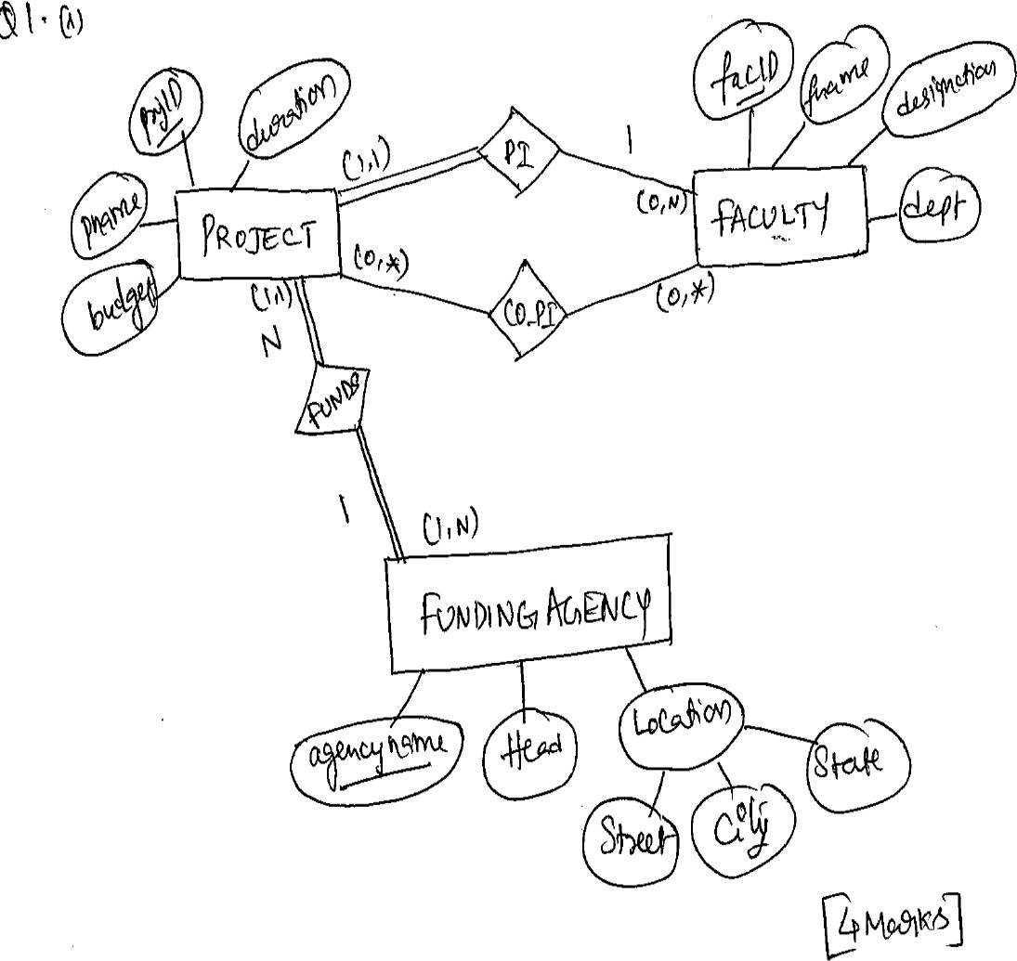

Slide 13
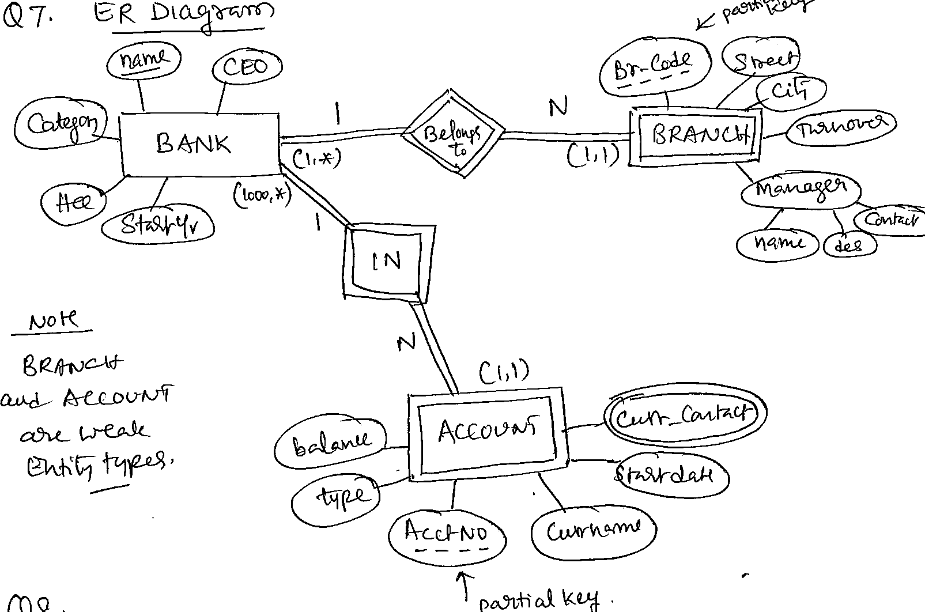

Slide 14
Mapping class hierarchies
We have 4 different approaches:
A: Multiple relations : super class and sub classes
(used for all specializations)
B. Multiple relations: subclass relations only (best suited for disjoint specialization )
C. Single relation with type attribute
(best for disjoint and with few specific attributes)
D. Single relation with multiple type attributes
(best for overlapping sub-classing and can work for the
other case as well).

Slide 15

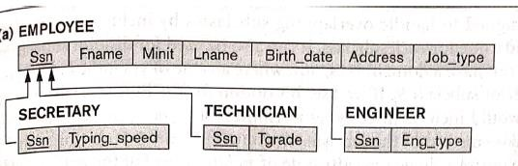
A: Multiple relations : super class and sub classes

Slide 16
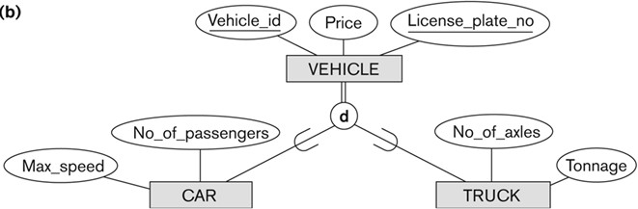
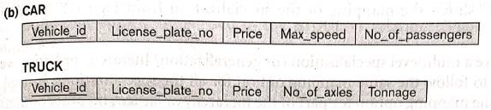
B. Multiple relations: subclass relations only

Slide 17

C. Single relation with type attribute

Slide 18
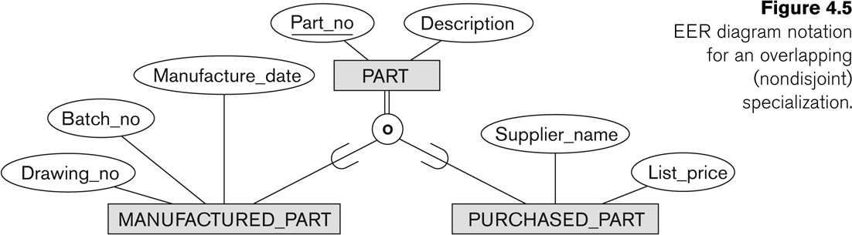
D. Single relation with multiple type attributes

Slide 19
Summary
ER to Relational Mapping
Mapping Entity types
Mapping Relationships
Mapping class hierarchies

